Slide 1
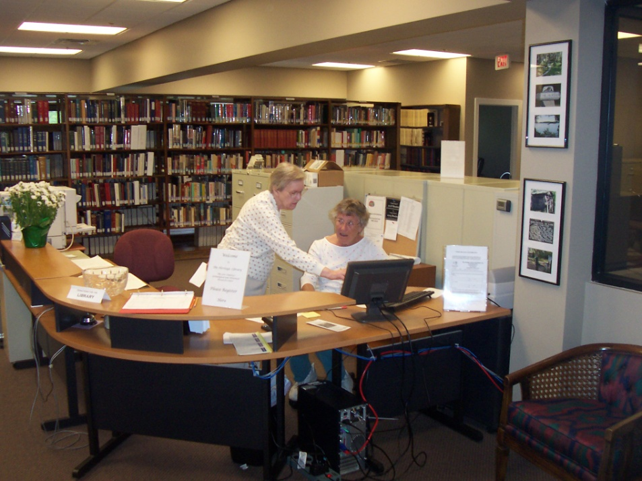
The Heritage Library
852 Wm. Hilton Pkwy’ Suite 2A
History and Heritage Research Library
Free to Students and teachers
www.heritagelib.org

Slide 2
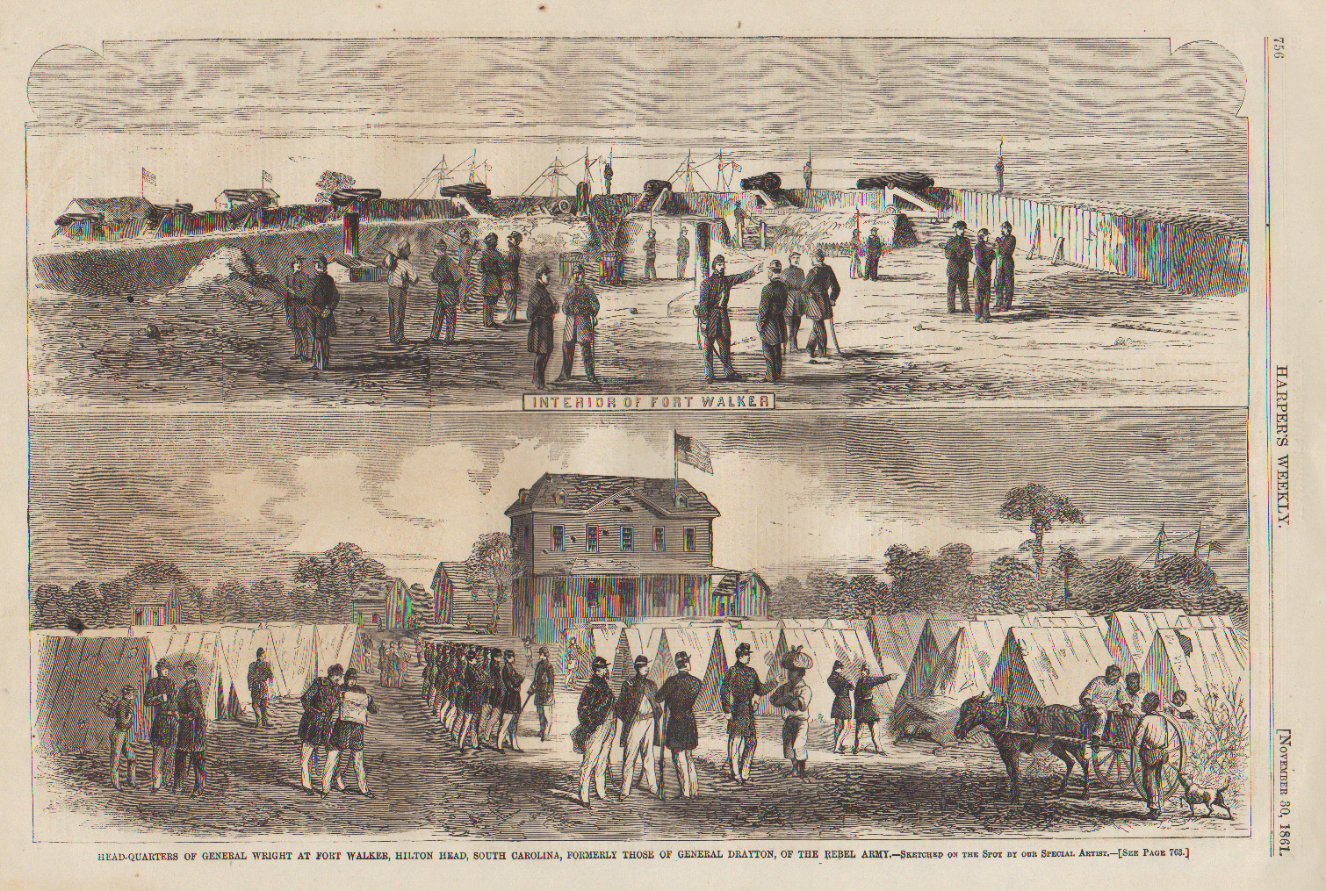
Fort Walker
Confederate Fort
Notes:
Built in July of 1861 at the entrance to Port Royal Sound to help protect the port of Savannah from Union attacks
Fort built near the spot claimed by British Captain William Hilton in 1663
Another fort, Beauregard, was built across the Sound
Less than a thousand Confederates at the two forts

Slide 3
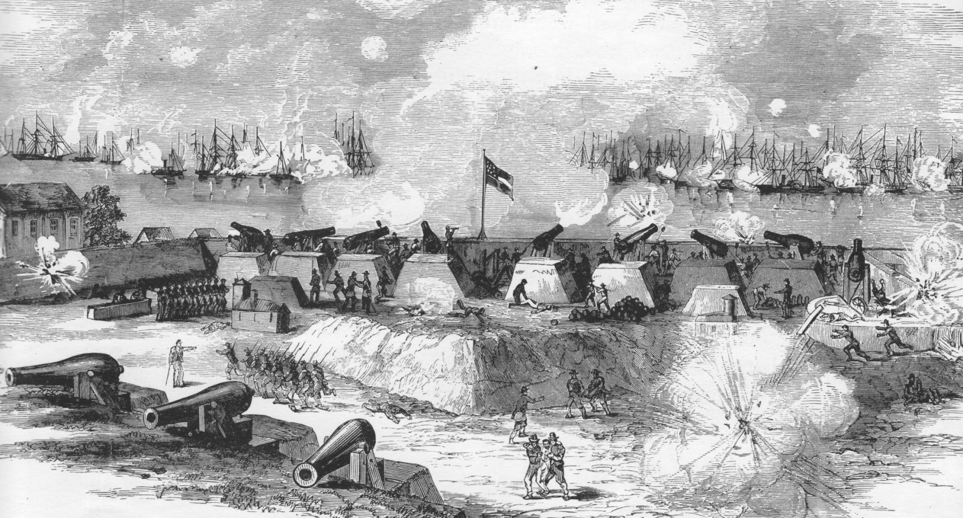
Battle of Port Royal- 1861
Notes:
BATTLE OF PORT ROYAL- 1861
This is an Artist’s depiction of the battle
The 12,000 troops under command of Brigadier General Thomas W. Sherman (no relation to William Tecumseh Sherman) constituted the largest amphibious assault by American forces until D-day.
Unlike most Civil War battles, the Battle of Port Royal had very limited casualties- The Union reported only 8 dead and 23 wounded. The Confederacy counted 11 dead, 48 wounded and 3 missing.
When Union forces landed on Hilton Head, they encountered no resistance and discovered that the white residents had already fled to mainland
Fort Walker became the Headquarters for the Union Army’s Department of the South and also the base for the Navy’s South Atlantic Blockading Squadron

Slide 4
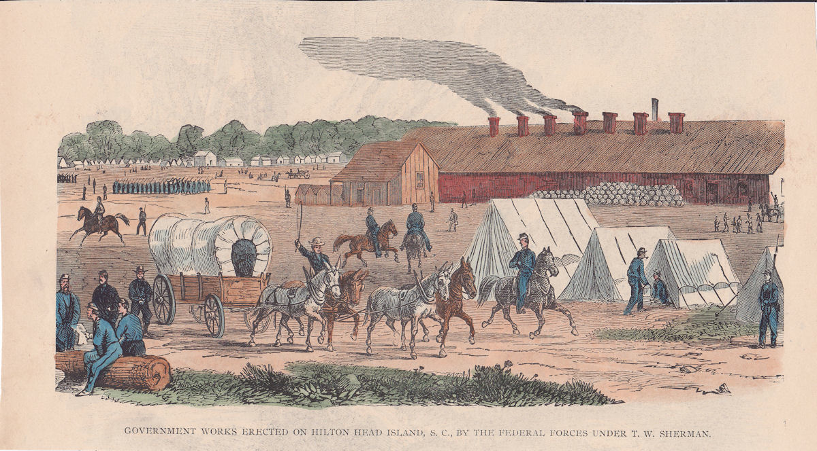
Hilton Head during the Civil War 1861-1865
Notes:
Rendition of Fort Walker. Fort served as Union southern headquarters for remainder of the war (1861-1865) Population swelled to more than 40,000. In addition to soldiers Civilian store-keepers, Missionaries , prisoners of war, Nurses. Actually a town with a three hotels, a couple of restaurants and lots of bordellos. Street called Robbers Row for all the right (or wrong) reasons.

Slide 5
General Ormsby MacKnight Mitchel
Notes:
GENERAL MITCHEL
American astronomer, attorney, professor, and publisher
Published first magazine in US devoted to astronomy
Known in Union Army as “Old Stars”
Until then, best known for ordering raid that became famous as the Great Locomotive Chase.
He was concerned with the living conditions of the contrabands and the fact that many of them were being cheated by the soldiers.
When establishing Mitchelville, General Mitchel proclaimed that the land the people of Mitchelville, South Carolina, had once toiled on under the chains of slavery was now their own. These are his words:
“Good colored people, you have a great work to do, and you are in a position of responsibility. This experiment is to give you freedom, position, homes, your families, property, your own soil. It seems to me a better time is coming … a better day is dawning.”
Died from yellow fever only 38 days after arriving on the island.

Slide 6
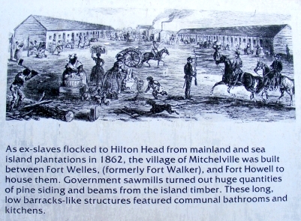
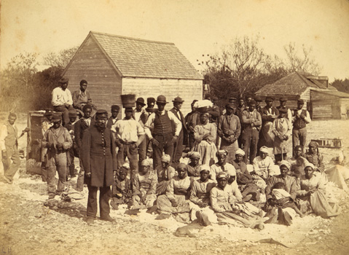
Mitchelville
Notes:
MITCHELVILLE
A number of “freed” slaves became soldiers- they were among the first regiments of what was to be known as the United States Colored Troops
The freed slaves, known as contrabands, were living in large barracks buildings with communal facilities and no family privacy.
General Mitchel was concerned with the living conditions of the contrabands and the fact that many of them were being cheated by the soldiers.
He established a village for the freed slaves by giving them each ¼ acre and sufficient lumber to build a home.

Slide 7
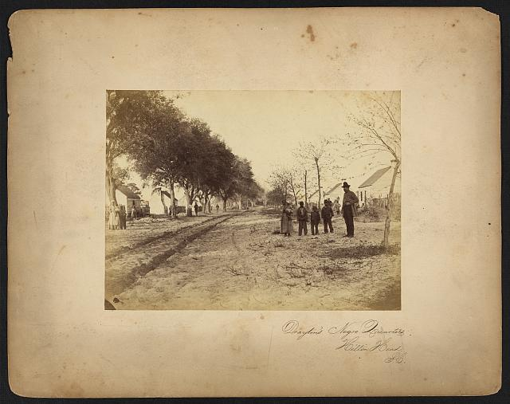
Drayton Plantation
Notes:
Drayton Plantation – famiies, guarded by a soldier.

Slide 8
Mitchelville
Notes:
After General Mitchel: The first mayor of Mitchelville was the Rev. Andrew Murchinson, who was also the first pastor of The First African Baptist Church that was founded in 1862 and built in Mitchelville. THE FREEDMAN’S VILLAGE WAS NAMED FOR THE GENERAL: MITCHELVILLE
Elected own officials
Passed own laws
Established first compulsory education law in state
Built along modern-day Beach City Road
Unfortunately, General Mitchel died of yellow fever 38 days after taking command (1862 Hilton Head name changed to Port Royal)
By end of Civil War, Mitchelville 1,500 former slaves
Sea Island slaves were the first to be freed in South.
Mitchelville marker inside Port Royal Plantation

Slide 9
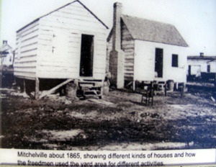
Scenes from Mitchelville
Notes:
FIRST FREEDMAN’S VILLAGE: MITCHELVILLE
Located in a cotton field on the former Drayton Plantation
Elected own officials
Passed own laws
Established first compulsory education law in state
Built along modern-day Beach City Road
By end of Civil War, Mitchelville was home to 1,500 former slaves

Slide 10
Fort Howell
Notes:
TO PROTECT RESIDENTS OF MITCHELVILLE FROM CONFEDERATE ATTACKS, FORT HOWELL WAS BUILT IN 1864
Earthworks fort built by 32nd United States Colored Infantry Regiment from PA.
At the end of the war Blacks constituted 1/10th Union Army

Slide 11
Mitchelville in 1864
Notes:
Mitchelville survived past the Civil War.
In January 1865, the Mayor, Rev. Abraham Murchinson answered the question “What will they do when the War is over?” He replied: “Go out into the land and make their homes here. Buy 20 acres of land. This is what should be: once settled on his 20 acres, no one can oppress the negro hereafter. But without land, all the teaching, all the philanthropy, all the Christianity of the world cannot save him from the oppression of his selfish neighbor who holds the means of bread in his own hands.”
In March 1865, Congress established the Freedmen’s Bureau to oversee housing, education and employment of freedmen. Over the next five years, Congress adopted amendments to the Constitution that outlawed slavery, conferred citizenship and the right to vote to former African slaves. In the Sea Islands many residents remained land owners and politically active. After the war some went on to positions in state government. Others remained committed to the education and civic participation of future generations of Gullah descent.

Slide 12
Fish Haul Park Map
Notes:
The Heritage Library recently hired a surveyor to do an overlay map of the 1864 Mitchelville map with what exists today. We determined that several structures existed within the boundaries of the Fish Haul Park. The footprint of one site (about 18 x 22 feet) has been marked off. There are several other sites within the park- one is a larger structure (about 25 x 50 feet), possibly a church or store. Since it is close to the water I believe that it is a church, possibly the original First African Baptist Church, which was founded in 1862. We will be doing further investigations to try to determine what it was.

Slide 13
Mitchelville Home Site
Notes:
This is the home site which has been marked off

Slide 14
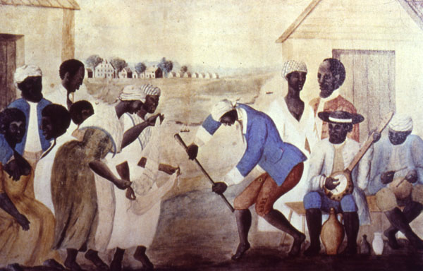
Gullah
Gullah
Notes:
FOLLOWING END OF CIVIL WAR, GULLAH ONLY RESIDENTS ON HILTON HEAD FOR NEXT SEVERAL DECADES
Descendants of slaves living in the low country and Mitchelville
Early ancestors came though Charleston and Savannah as slaves coming from Sierra Leone by the way of Brazil.
Name may derive from Gola tribe from W. Africa near Liberia where many of the Gullahs originated.
Gola is also their word for “forest” where W. Africans would go to try to find God
Have own language, culture, and community life
Famous painting, “The Old Plantation,” about 1790 shows Gullah slaves dancing and playing musical instruments from Africa. Scarf dance by women. Traditional instruments by men.
Kept their own culture because different from slaves in states like VA and N. Carolina they did not have interactions with whites.
Only overseers and managers lived on the Island, so there were very few whites that they came in contact with.

Slide 15
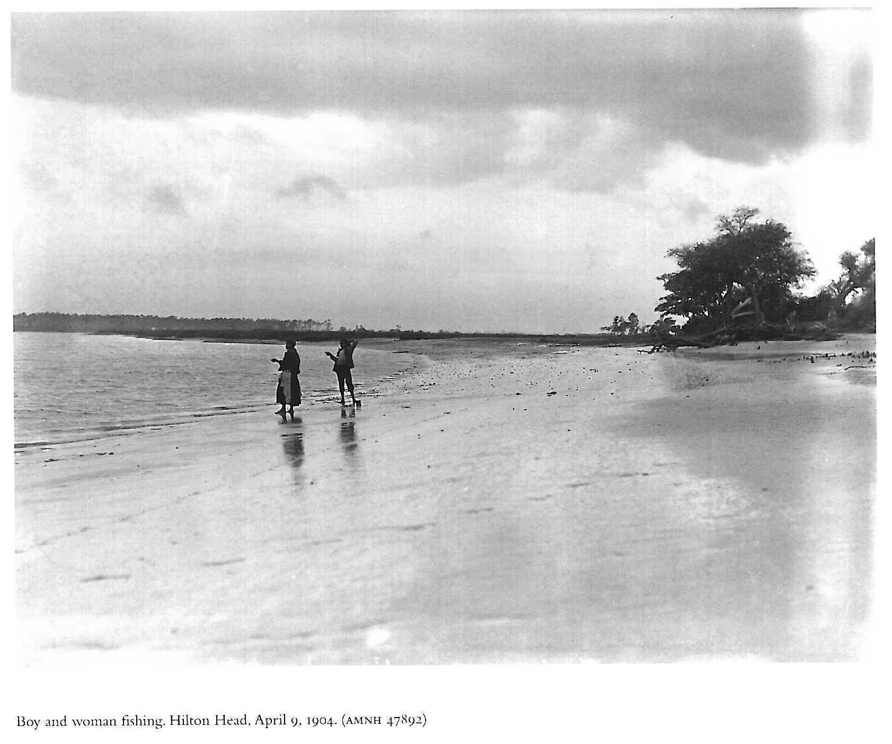
Planters abandoned the island
Fishing
Photograph by Julian Dimock
Notes:
PLANTERS HAD ABANDONED THEIR PLANTATIONS
Moved away because of labor issues (no slaves to provide free labor)
Most former plantation owners did not feel it was worth paying the Taxes levied on their property by the Federal gov’t. for land that they could no longer profitably plant.
1870 and 1880 U.S. Censuses account for about 2,500 blacks and only 40 whites living on the island
Mitchelville resorted to subsistence farming, fishing and shrimping for their livelihood
Attempts to grow cotton failed-low quality seeds and the boll weevil
The Great Sea Island Storm of 1893 wiped out half the population- by 1950 there were only about 600 residents on the island
Could continue to practice traditional culture with little influence from the outside world.
The freedmen families lived in near isolation from the rest of the world until the 1950’s. Their West African traditions became the foundation for the rich Gullah culture which survives to this day.

Slide 16
The Heritage Library
852 Wm. Hilton Pkwy’ Suite 2A
History and Heritage Research Library
Free to Students and teachers
www.heritagelib.org

